Slide 1
Referral based Diet Management System
By-Chandra kishor

Slide 2
Introduction-
Referral based diet management system have 3 different kind of users-
1. Admin who accept & update the requests of the challengers and assign them batches and upload weekly diet and workout plans, also chat with challengers for the updates.
2. Motivator who can chat with challengers for the updates and see there daily and monthly logs.
3. Challengers who enrolled themselves for diet-plans and workout-plans and they can upload there daily logs and monthly measurements for the track of improvements.

Slide 3
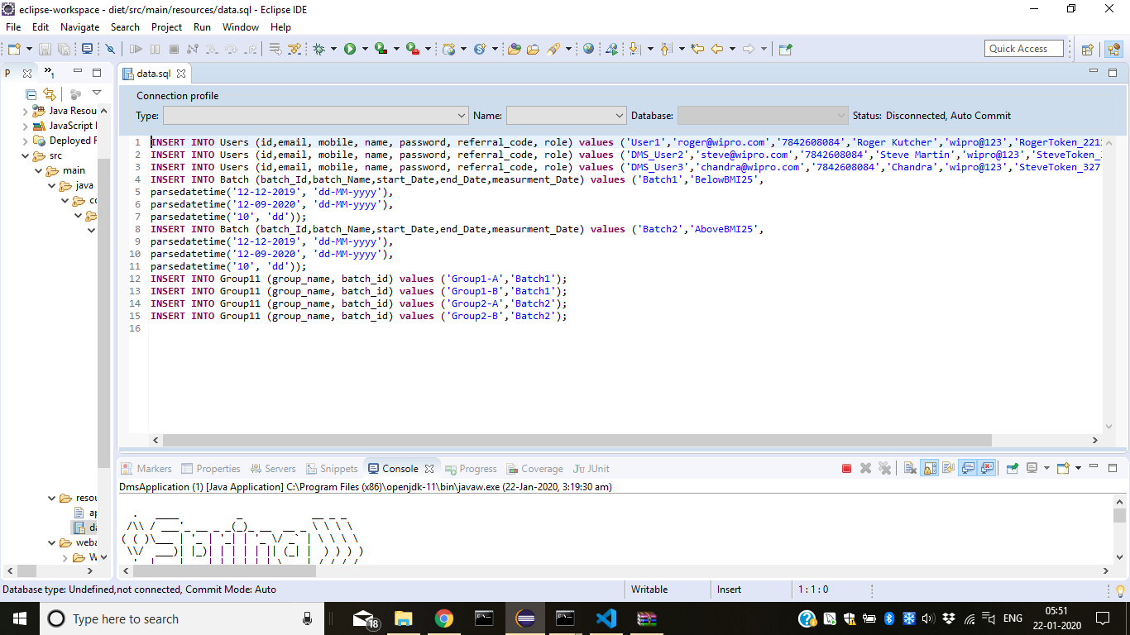
Database design & Tables-

Slide 4
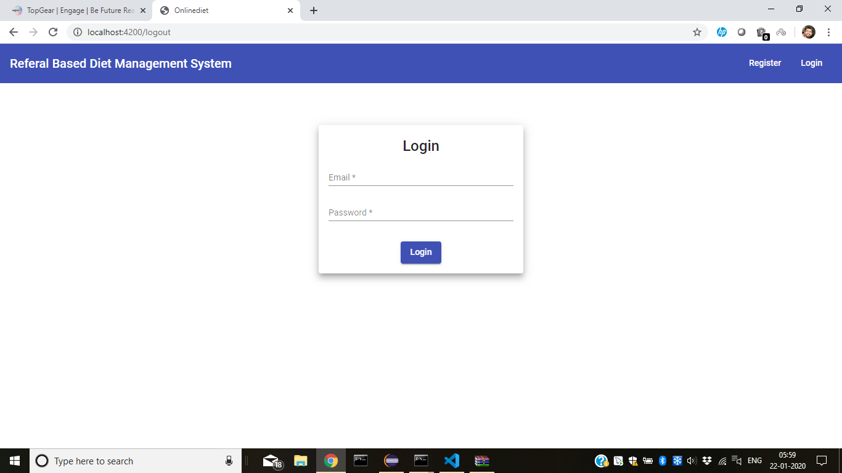
Workflow- login page

Slide 5
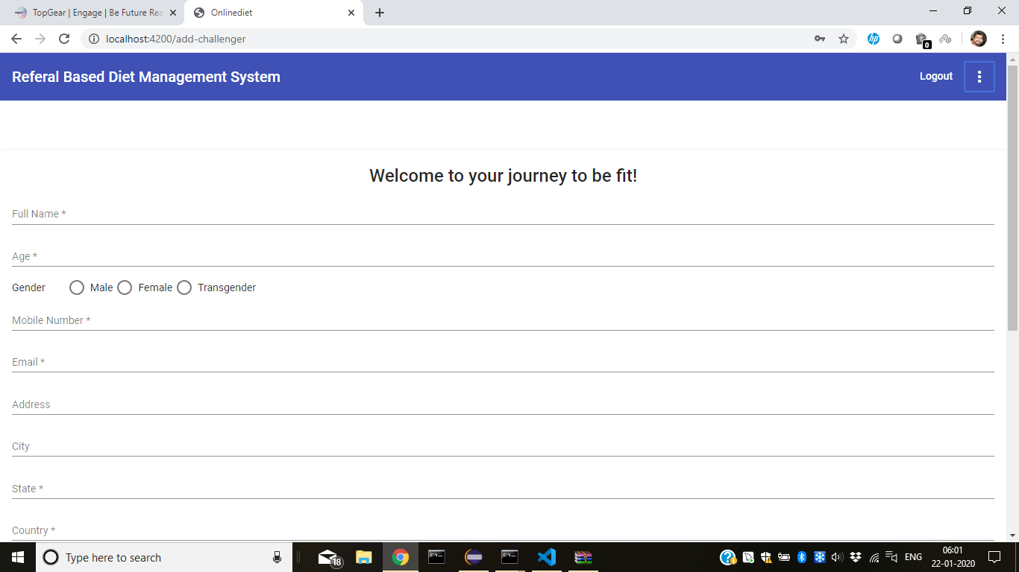
Registration page-

Slide 6
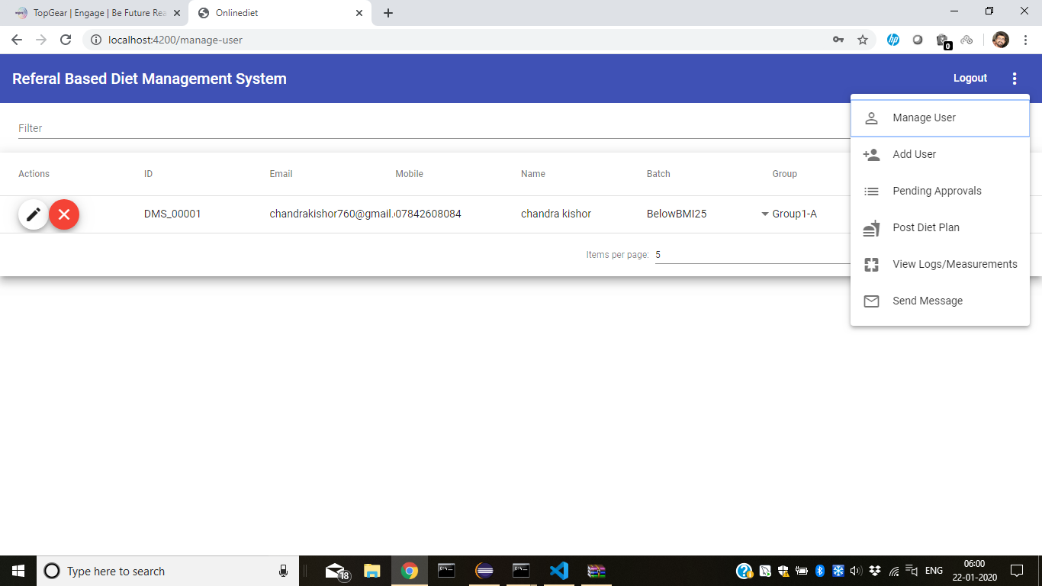
Admin Dashboard-

Slide 7
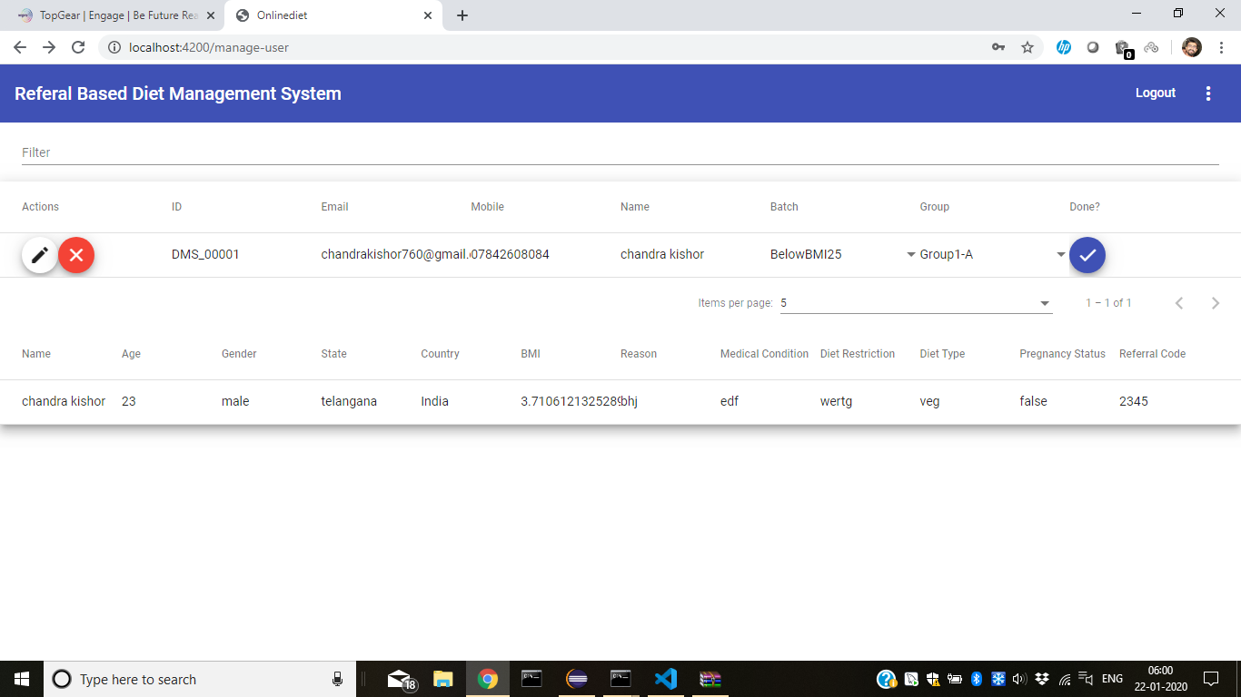
Admin Manage User-

Slide 8
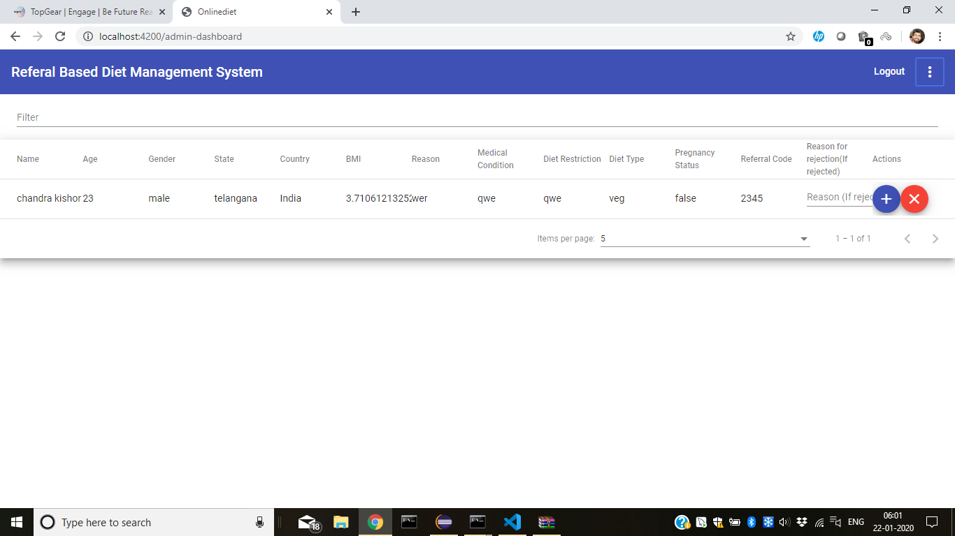
Admin Pending Requests-

Slide 9
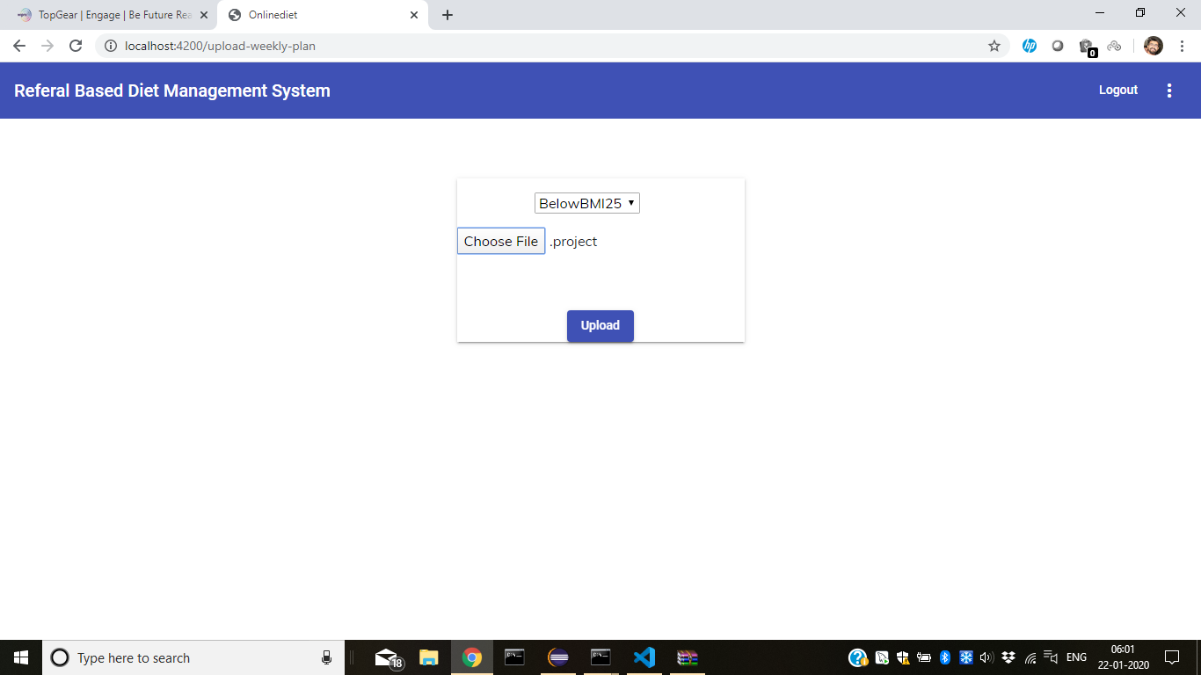
Admin Upload Weekly Plans-

Slide 10
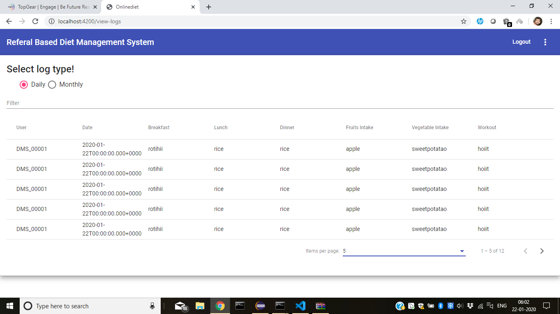
Admin Daily log View-

Slide 11
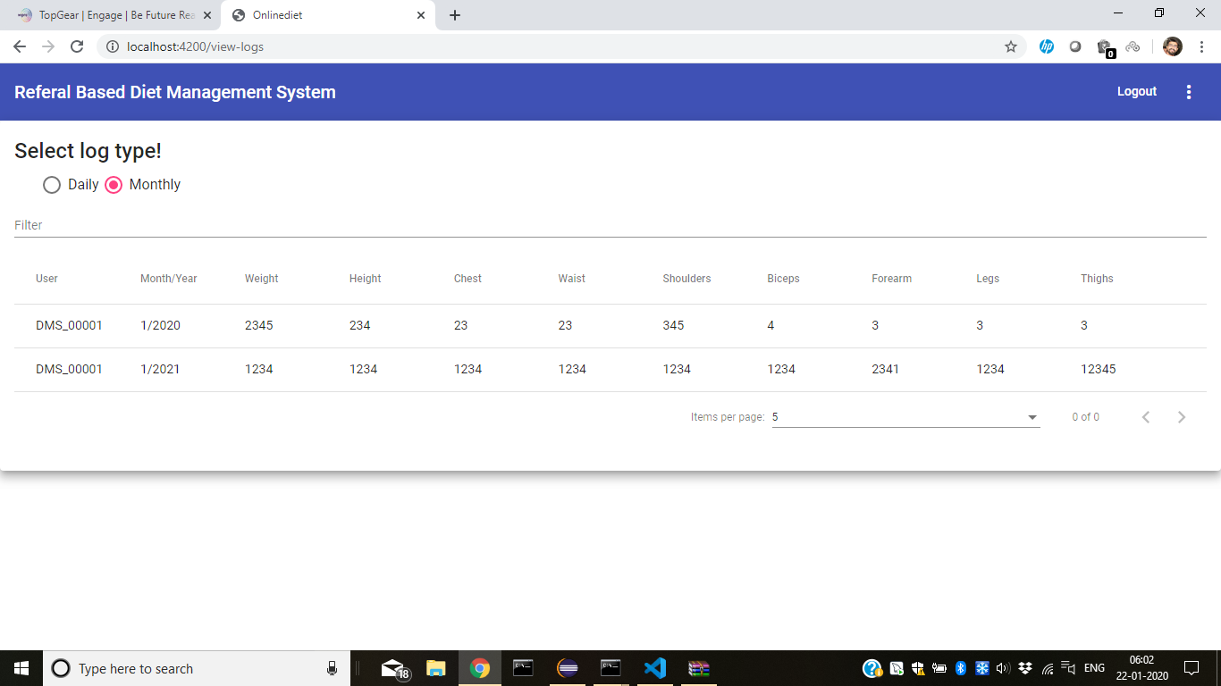
Admin Monthly log View-

Slide 12
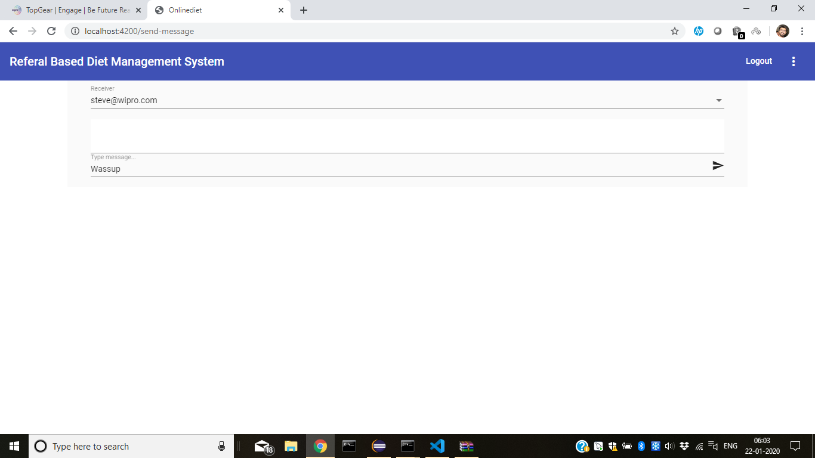
Messaging-

Slide 13
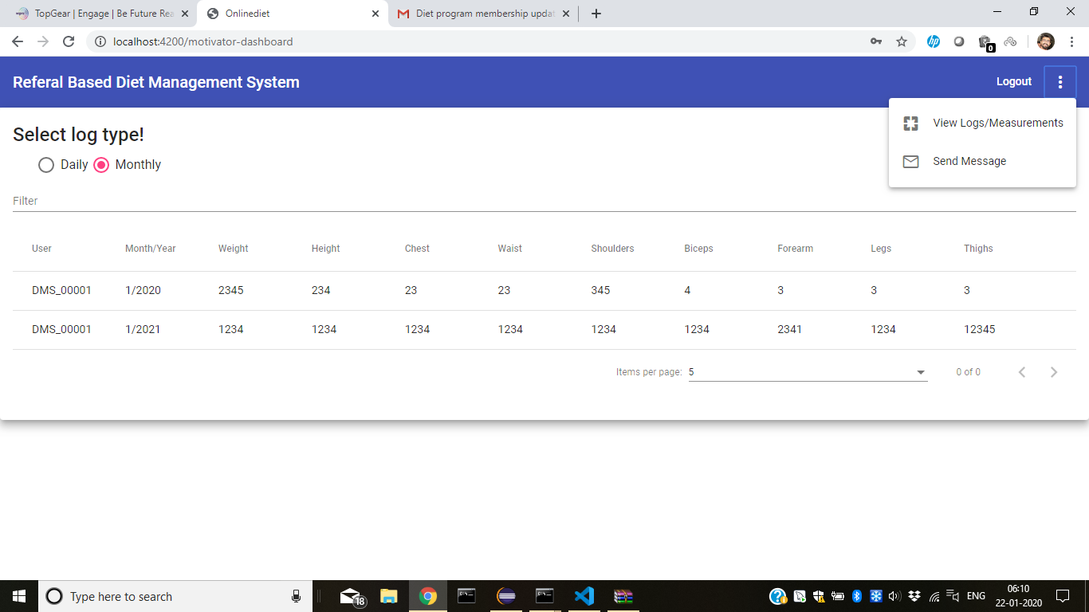
Motivator Dashboard-

Slide 14
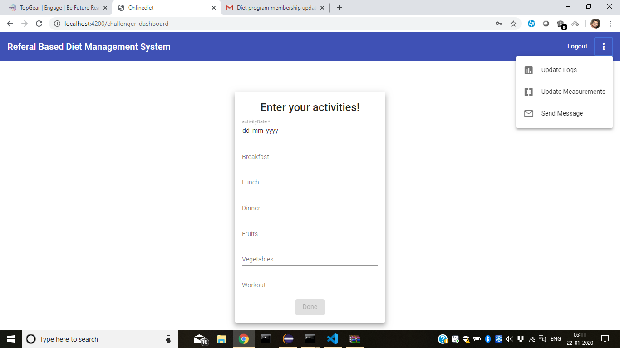
Challenger Dashboard-

Slide 15
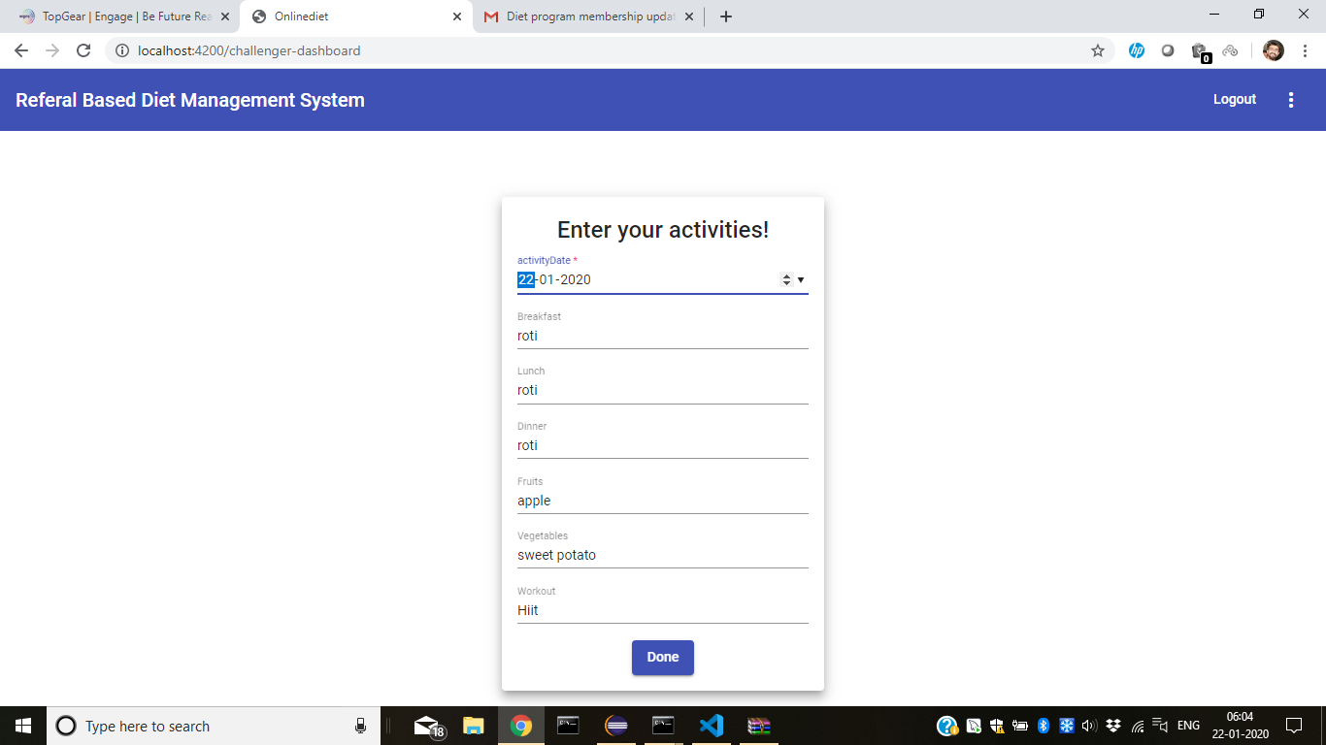
Challenger Daily log Upload-

Slide 16
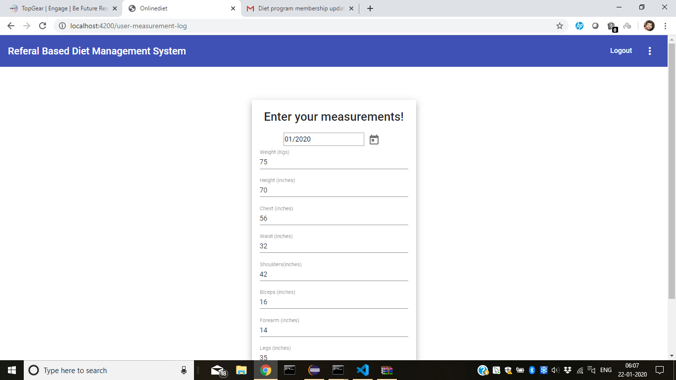
Challenger Monthly log Upload-

Slide 17
Thank You.

